Slide 1

Dynamics CRM Administration and Maintenance

Slide 2

Mitch Milam
Dynamics CRM Architect
mitch@xrmcoaches.com
blogs.Infinite–x.net
@mitchmilam

Slide 3
Teaching Tuesdays
Cast your vote now
http://tinyurl.com/TeachingTuesdays

Slide 4
Agenda
Reviewing System Maintenance Jobs
Troubleshooting workflow and plugin issues
Managing historical system job information
Monitoring the Windows Event Log
Using CRM Tracing
System Job Editor
User management tricks and tips
E–mail Management

Slide 5
Standard Procedures

Slide 6
Reviewing System Jobs
Build Personal Views
Monitor system jobs on a regular basis
Take action to correct issues

Slide 7
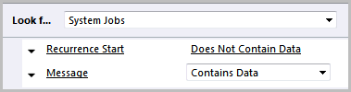
Personal View #1
System Jobs with Messages

Slide 8
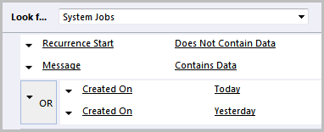
Personal View #2
System Jobs with Messages (Recent)

Slide 9

Personal View #3
System Jobs (Canceled or Failed)

Slide 10
Systems Job Cleanup

Slide 11
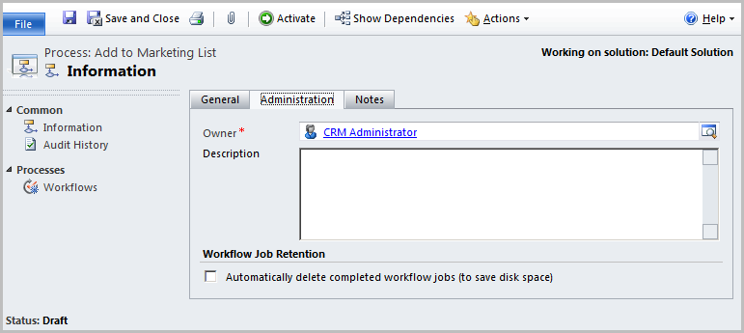
System Job Management: Workflow Execution
Auto-delete successfully completed workflows

Slide 12
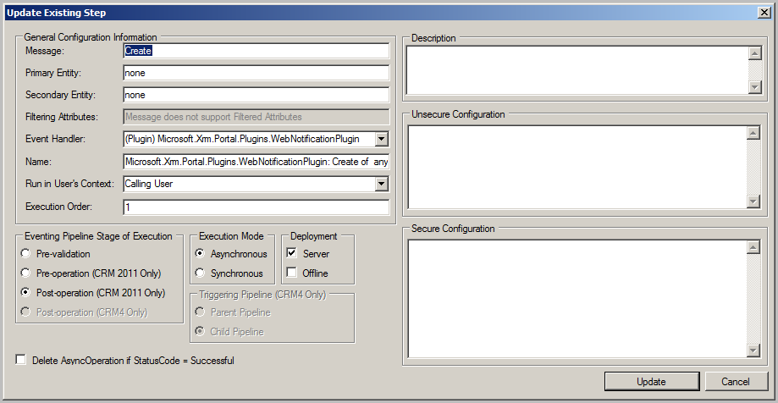
System Job Management: Plugin Execution
Auto-delete successfully completed asynchronous plugin steps

Slide 13
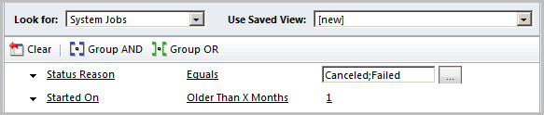
System Job Management: Bulk Delete
Remove canceled or failed jobs

Slide 14
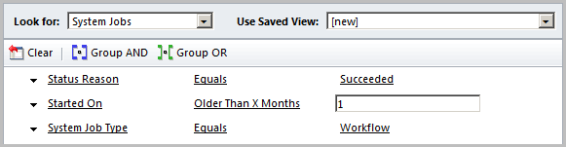
System Job Management: Bulk Delete
Remove successful workflows

Slide 15
E–Mail Management

Slide 16
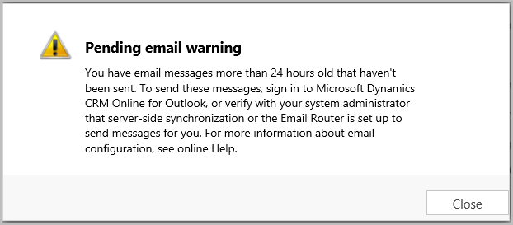
E–Mail Management

Slide 17
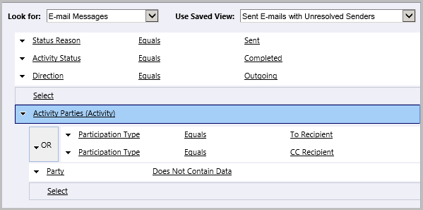
E–Mail Monitoring
E-mails with unresolved senders

Slide 18
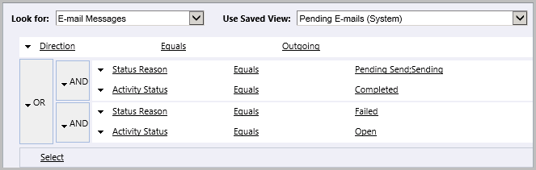
E–Mail Monitoring
Pending E-mails

Slide 19
User Management

Slide 20
User management tricks and tips
System Views
Disabled users consuming licenses
Users with no assigned security roles
Users: Primary E-Mail (Pending Approval)

Slide 21
Personal View – Enabled Users (Detail)
Full Name
Primary E-mail
E-mail 2
Business Unit
Access Mode
License Type
Restricted Access
Incoming E-mail Delivery Method
Outgoing E-mail Delivery Method
Primary E-mail Status

Slide 22
Workflow Best Practices

Slide 23
Workflow Best Practices
Do not stop a workflow with a status of Cancelled
Periodically verify your workflow inventory and usefulness
Disable or delete unused workflows

Slide 24
Online Procedures

Slide 25
Alerts
New to Dynamics CRM 2015
Mostly captures issues with Server–Side Sync email

Slide 26
Plug–in Trace Log
New in Dynamics CRM 2015 Spring Release
Allows you to safely capture plug–in exceptions

Slide 27
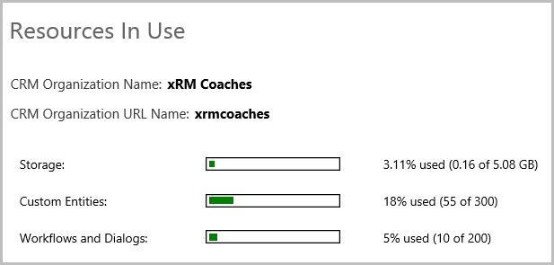
Monitor Resource Utilization

Slide 28
Get A Space Utilization Report
Available from CRM Online Support
Shows top database tables consuming space

Slide 29
Utilization and Emails
Be mindful of your attachments
Establish a procedure for “no images” in your signature block

Slide 30
On–Premise Procedures

Slide 31
System Job Management

Slide 32
System Job Management: SQL Cleanup
Article: Performance is slow if the AsyncOperationBase table becomes too large in Microsoft Dynamics CRM
http://support.microsoft.com/kb/968520

Slide 33
Windows Event Log

Slide 34
Monitoring the Windows Event Log
Monitor the Application Event Log
Filter on Warnings and Errors
Examine each looking for problems and patterns.

Slide 35
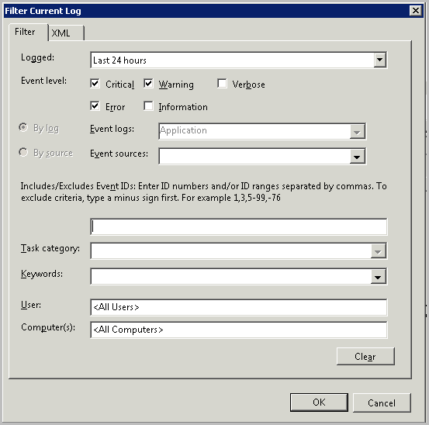
Windows Event Log Filtering

Slide 36
CRM Event Tracing

Slide 37
Using CRM Tracing
Article: How to enable tracing in Microsoft Dynamics CRM
http://support.microsoft.com/kb/907490
Diagnostics Tool for Microsoft Dynamics CRM 2011
http://crmdiagtool2011.codeplex.com/
Trace Log Viewer
http://www.stunnware.com/crm2/topic.aspx?id=tracelogviewer

Slide 38
Using CRM Tracing
Troubleshooting Actions
Turn on Tracing
Reproduce the error
Review the trace log

Slide 39
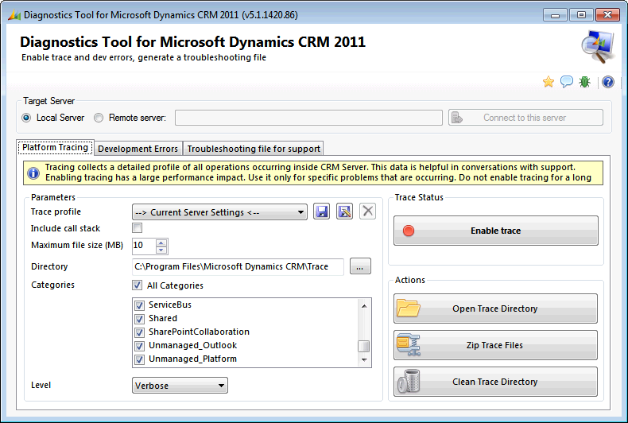
Using CRM Tracing: Diagnostics Tool

Slide 40
Using CRM Tracing
Match Error Codes
Reference number for administrators or support: #7729DCC1

Slide 41
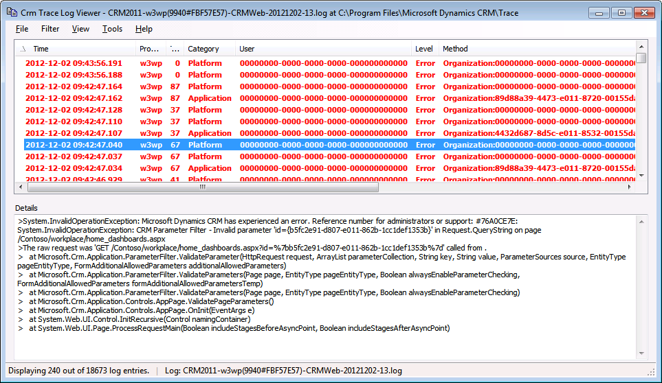
Using CRM Tracing: Log Viewer

Slide 42
CRM 201x System Job Editor
Reschedule the system jobs to off-hours
Article: More juicy details on Dynamics CRM 2011 Asynchronous Service’s maintenance jobs
http://blogs.msdn.com/b/crminthefield/archive/2013/02/07/more-details-on-dynamics-crm-2011-async-service-maintenance-jobs.aspx

Slide 43
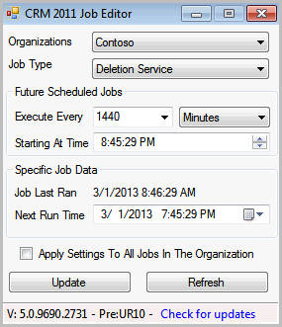
CRM 201x System Job Editor

Slide 44
Summary
Reviewing System Maintenance Jobs
Troubleshooting workflow and plugin issues
Managing historical system job information
Monitoring the Windows Event Log
Using CRM Tracing
System Job Editor
User management tricks and tips
E–mail Management

Slide 45
CRM Administration Deep Dive Book
21 Squared: Administration (On–Premise)
http://tinyurl.com/21squaredadmin
Discount Code
21sAdminDeepDive
Expires June 30

Slide 46
Questions?

Slide 47
Thank You

